Slide 1
California real estate price prediction
UC Berkeley Machine learning capstone project
By: Vinay Jain
July 31, 2024

Slide 2


Introduction
This presentation highlights the key areas of the capstone project – Prediction for California’s real estate prices
Key areas include:
Data understanding
Exploratory data analysis (EDA) and Data cleansing – key findings
Summary of the exploratory data analysis (EDA)
Feature engineering
Modeling
Visualization of features
Interpretation and summary of modeling analysis
Next steps

Slide 3
Data understanding

Slide 4

data understanding
Dataset contains real estate listing for the state of California (US) for the first 6 months of 2021.
Prices (target values) are listed in USD.
Source: Dataset is from Kaggle: https://www.kaggle.com/datasets/yellowj4acket/real-estate-california/data

Slide 5
Exploratory data analysis

Slide 6
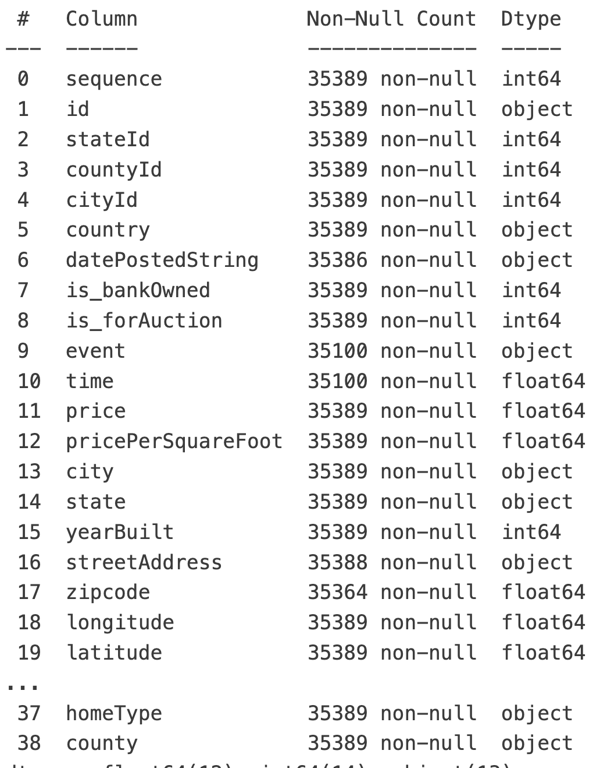
Exploratory Data Analysis (EDA) - 1
Original Data
Dataset contained a total of 35,389 records with 39 columns.
Dataset was pretty clean in itself with no apparent null values present in the dataset.
Easy pickings:
Highly unique columns like sequence, and id – would not help with modeling so they can be dropped.
A number of redundant columns could be dropped (like state, stated, country, and currency) since the dataset was already constrained to California.
‘datePostedString’ showed few records from prior to 2021 so those can be dropped.
Since the data was now constrained to 6-month timeframe, no time series modeling was needed. As such this column can be dropped.

Slide 7
Exploratory Data Analysis (EDA) - 2
Location
Original Data
Location is represented using a variety of columns:
country
state, stateId
county, countyId
latitude, longitude
streetAddress
zipcode
‘zipcode’ was chosen as the only attribute to represent location to avoid having other location attributes compound the feature weights considering zipcode provides a decent level of granularity.
‘zipcode’ can be treated as a categorical column.

Slide 8
Exploratory Data Analysis (EDA) - 3
homeType = Single family home
‘homeType’ consisted of ‘SINGLE_FAMILY’ as the primary value. The rest of the homeTypes were throwing outliers on the price, so records for other homeTypes were dropped. Since homeType now contained only one value, it could be dropped.
Given that the dataset was now restricted to single family homes, it can be safely assumed that they all have at num of bathrooms >0 num of bedrooms > 0. So records where either of them are zero can be dropped.
Considering single family homes do not have pet restrictions, the ‘hasPetsAllowed’ column did not hold any meaningful presence in the dataset so it can be dropped.
Very few records existed for ‘is_bankOwned’, and ‘is_forAuction’ with value of 1 (true). So as to avoid throwing outliers in the analysis, records with value of 1 can be dropped and then these columns can be dropped.
Levels contained a lot of unique values. I have consolidated that set into 4 unique values (‘One’, ‘Two’, ‘Multi/Split’ and ‘Other’).

Slide 9
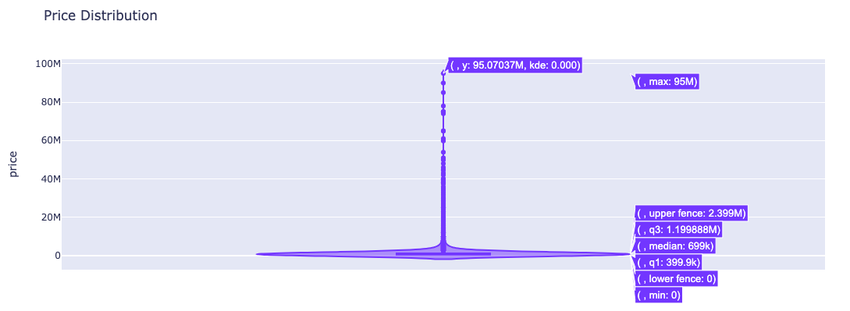
Exploratory Data Analysis (EDA) - 4
‘price’ (target)
‘price’ column had a wide range of values:
Minimum: 0 (a 0 indicates a record is not useful for our purposes)
Lower fence: -$80K (of course a negative value does not true for price)
Upper fence: $239K
Max: $95M
Given the wide range, anything outside of the upper fence would be an outlier
Dropped about $3K records since they had an outlier price

Slide 10
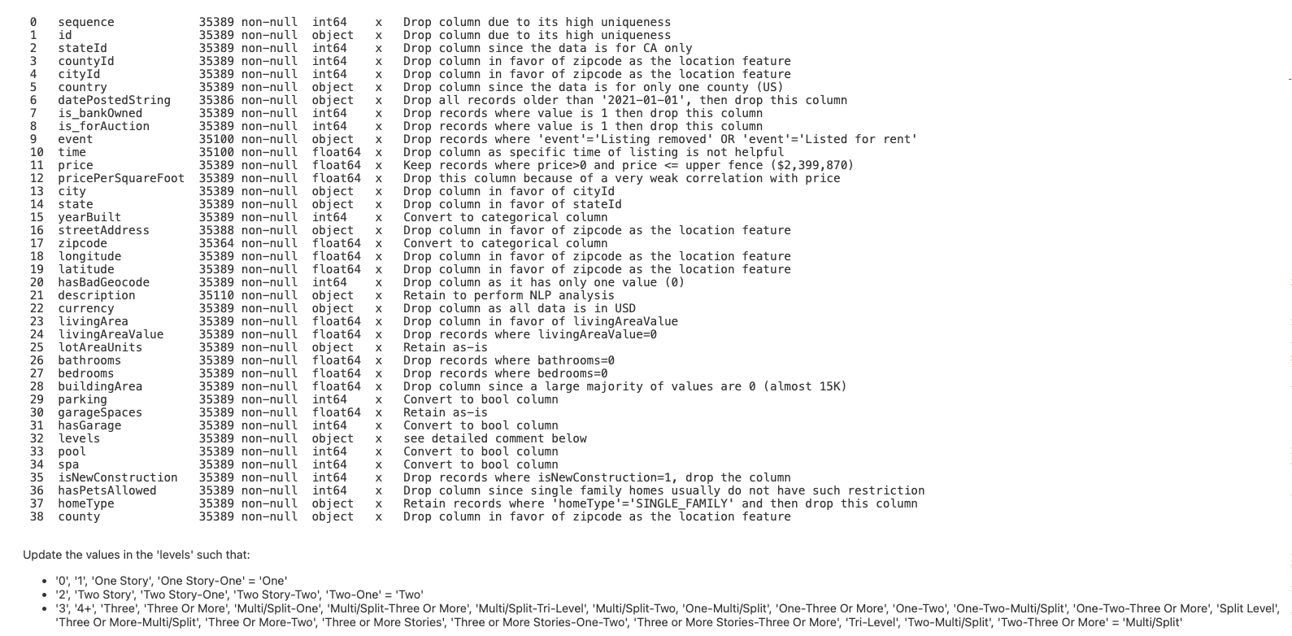
Summary of EDA for all 39 columns
Detailed analysis of each of the 39 columns can be found in the data analysis notebook

Slide 11
data cleansing

Slide 12
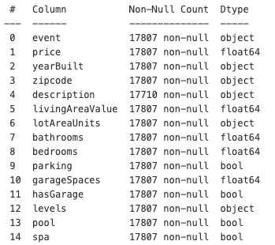
Revised dataset after cleansing - Summary
After applying all the learnings from analysis, performing data cleansing and dropping columns, dataset now contains
17,807 records (compared to 35K in the initial dataset)
15 columns (compared to 39 in the initial dataset)
All record columns are free of null values (except ‘description’)
Converted columns referring to Boolean values from Integer to bool data type
Converted columns like yearBuilt and zipcode to categorical columns
Consolidated variety of values for levels into a much smaller set

Slide 13
Feature engineering

Slide 14

Added these new columns
Age of the House: Calculate the age of the house by subtracting the year built from the current year (or a reference year=2021)
Drop the ‘yearBuilt’ column since ‘AgeOfHouse’ now represents the year built information.
Living Area per Room: Divide the living area by the number of rooms to get a measure of space per room.
Bath to Bedroom Ratio: bathrooms / bedrooms
Garage to Bedroom Ratio: garageSpaces / bedrooms

Slide 15
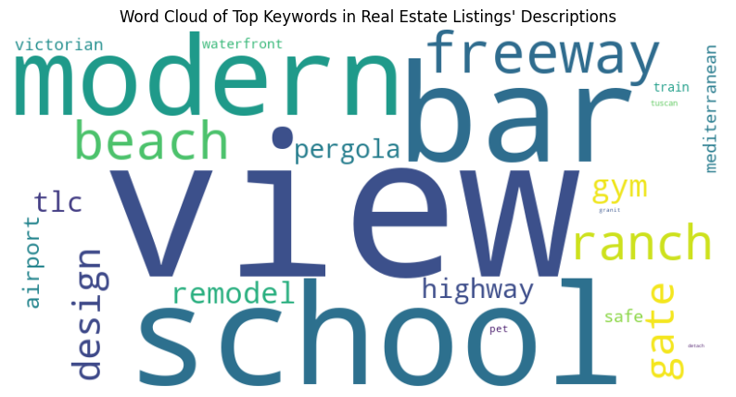
Derive keywords from ‘description’ field
Used NLP to analyze the ‘description’ field for a variety of keywords that might be related to a property’s features, condition, location/neighborhood, style/layout, amenities, and terms
Added these as additional new categorical columns with one hot encoding to the dataset

Slide 16
Regression Modeling techniques

Slide 17
regression Modeling - summary
Eight different modeling techniques were applied. With each model, various hyper parameters were tried and obtained the following results:
Model | Training RMSE | Test RMSE | R-squared (Train) | R-squared (Test) | Fit time (secs)
Ridge | 194,859 | 223,847 | 0.8317 | 0.7847 | 1.205
Gradient Boosting Regressor | 313,070 | 338,684 | 0.5656 | .5071 | 132.84
Lasso | 192,422 | 223,941 | 0.8359 | 0.7845 | 4.698
Neural Network | 160,483 | 225,695 | 0.8858 | 0.7811 | 291.001
LinearRegression_Poly1 | 341,489 | 351,380 | 0.4831 | 0.4695 | 8.9724
LinearRegression_Poly2 | 541,458 | 545,900 | -0.2994 | -0.2805 | 1.9862
LinearRegression_Poly3 | 317,795 | 344,053 | 0.5524 | 0.4914 | 1.7184
LinearRegression_Poly4 | 312,203 | 1.36154e+06 | 0.568 | -6.9655 | 2.2513

Slide 18


Modeling Techniques - Winner
Across the 8 modeling techniques applied (using various hyperparameter tuning across many iterations), Ridge modeling technique edged to be the winner model.
Ridge model had:
Lowest RMSE (Test) – 223, 847
Highest R-squared (Test) – 0.7847
Lowest Fit Time – 1.2051 seconds
Lasso, Neural Network, and Gradient Boosting models were close to Ridge in terms of Test RMSE but when looked at the trio factors including R-squared (Test) and Fit time, Ridge came ahead.
Linear Regression with various factors (1 through 4) did not perform well.

Slide 19
Feature importance

Slide 20
KEY highlights for features impacting ridge model
Bathrooms Reign Supreme: The most important feature by far is the number of bathrooms. This reinforces the well-known fact that more bathrooms are strongly associated with higher house prices.
Space is Key: The feature LivingAreaPerRoom, representing living area per room, has a significant importance score. It suggests that buyers value houses with ample space per room.
Notable Factors: Price change event, number of garage spaces, Bath to Bed ratio and number of bedrooms round up the top 10 impactful features.
Location is Crucial: Some zip codes with significant importance scores, such as 94080 (south San Francisco), 95051 (Santa Clara),and 94941 (Marin County).
These zip codes represent the high impact they have on contributing to the Ridge model’s price predictions.
Gold nuggets in the 'description' field: Its interesting to note that mention of beach and architectural styles like the ranch play a significant factor too.

Slide 21
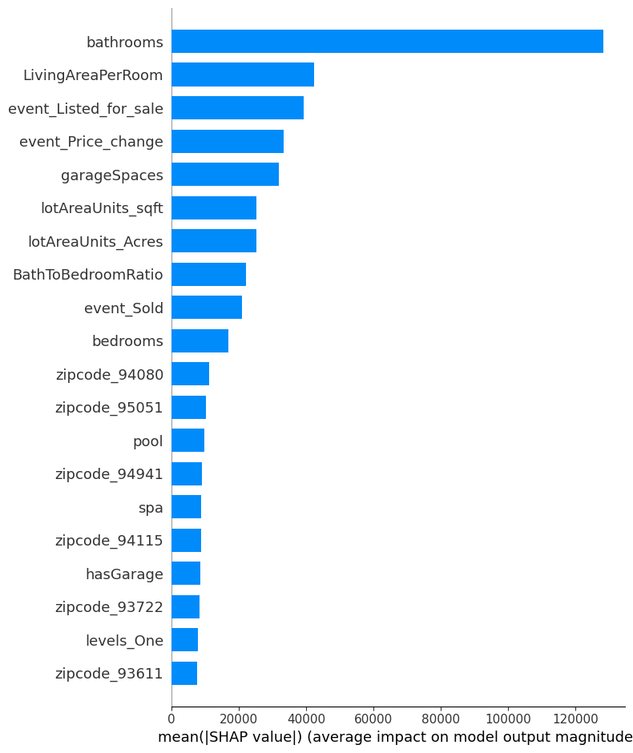
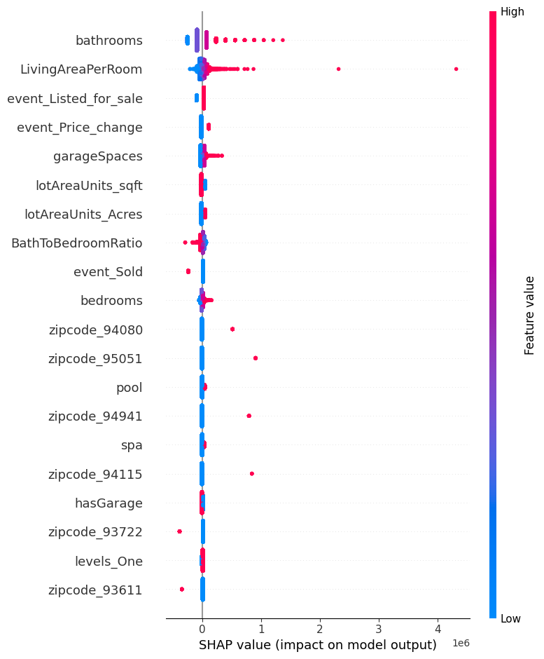
Avg feature impact on model output
SHAP (SHapley Additive exPlanations) charts
SHAP VALUE impact on model output

Slide 22
Next steps

Slide 23
Potential Next steps on how to improve accuracy of the model
Home prices are also impacted by a few other factors that are not available in the dataset available.
Use Latitude and Longitude to identify additional location-based details such as: Crime rate, proximity to good schools, proximity to airports/train tracks, highways, shopping centers, etc.
Using street address, identify additional property related records – perhaps using government records - for property tax, association fees, number of acres of the land, specials fees/assessments, etc. that can play a significant portion in deciding the cost of house.
Using the listing date, identify if it is a buyer's market or seller’s market. Economic conditions may dictate influence on prices too.
Adding other such details in the mix will likely reduce the RMSE further down making it a better model in predicting house prices with higher confidence.

Slide 24
Thank you

Slide 25
Thank you!
The capstone project gave me a chance to apply many of my learnings from this course:
Data analysis with various visualizations
Data cleansing and pre-processing
Feature engineering
Natural language processing
Modeling with Neural Networks, Gradient Boosting, Ridge, Lasso, Linear Regression with different polynomial factors and applying various type of hyperparameters for tuning
Feature importance analysis
It was good to learn so many nuggets from Prof. Hug and Prof. Gomes – truly great teachers!
Thank you Sherdil for recommending this project!

